Slide 1

Challenge 1: Network Intrusion Detection
Team E:
Resham Gala
Dan Ryan
Mike Tondu
Mustafa Demir
Sina
Nacho
Hani Eid

Slide 2
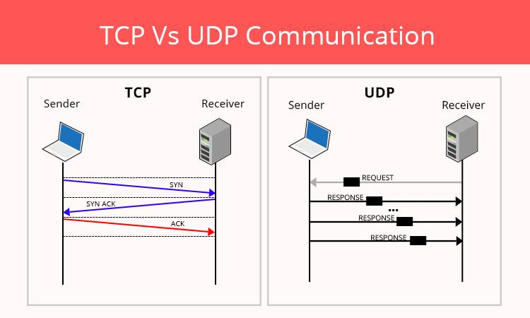

Networking

Slide 3
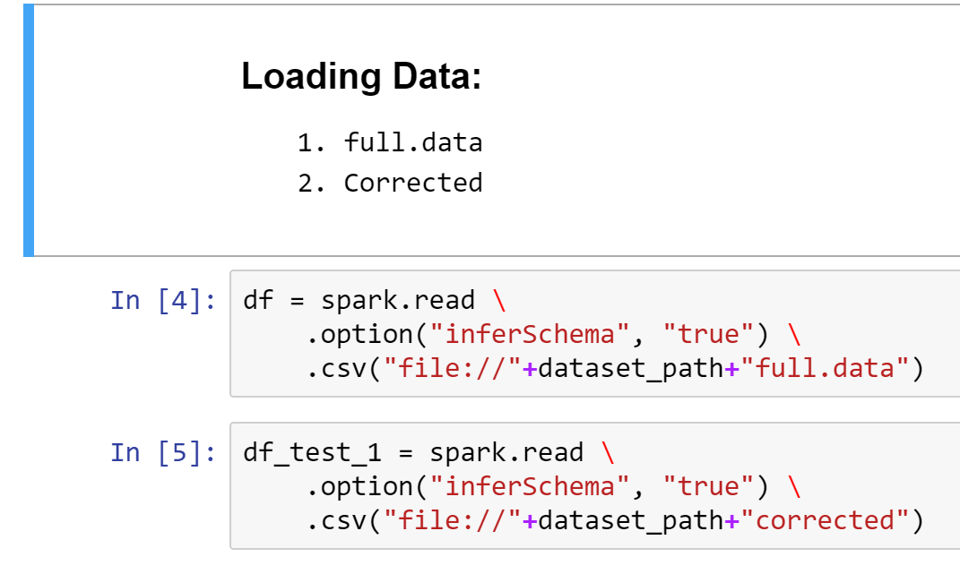
Data Loading

Slide 4
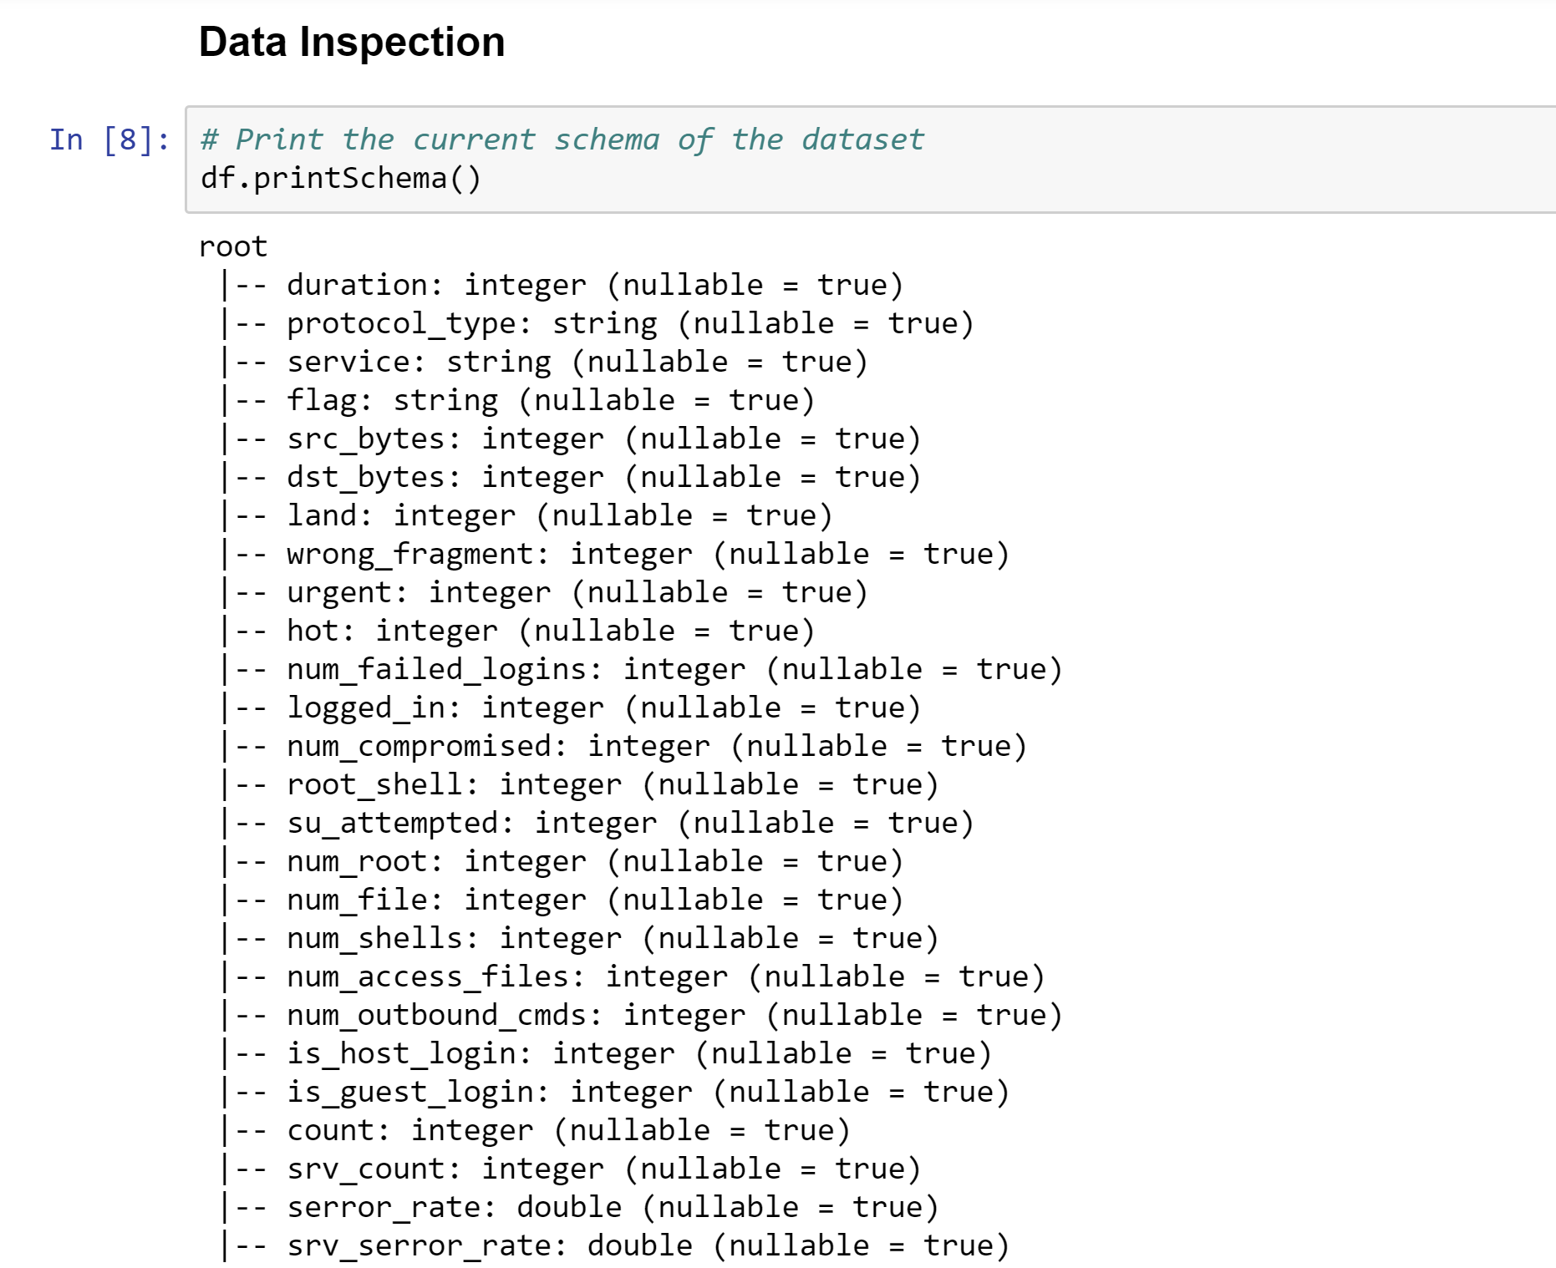
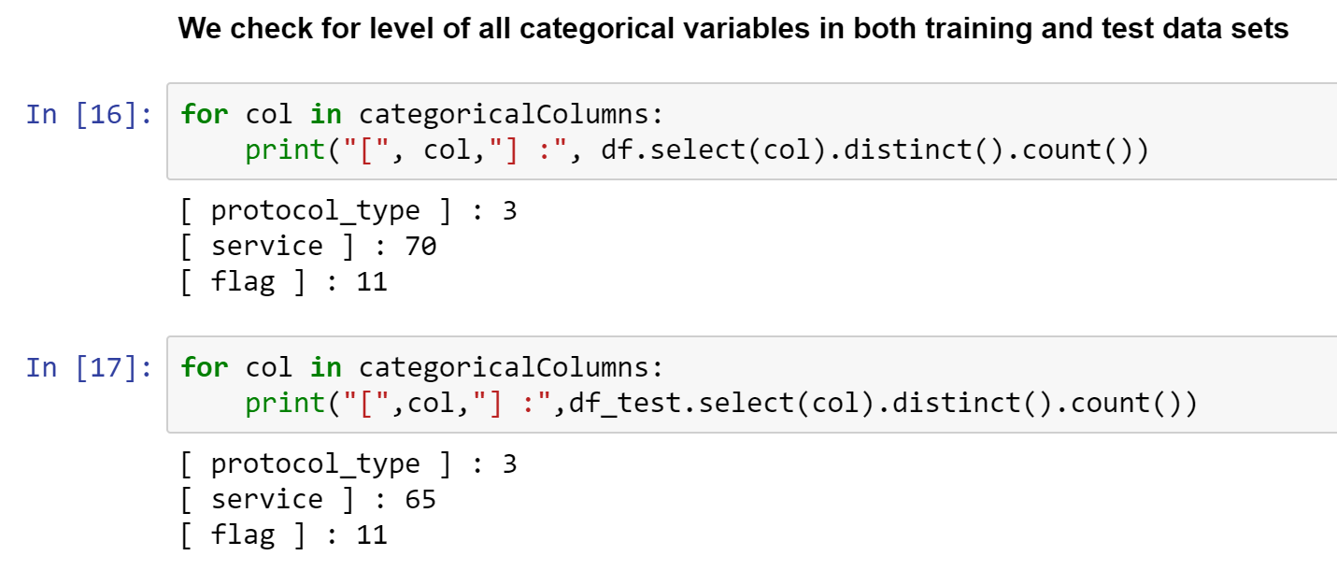
Data Inspection

Slide 5
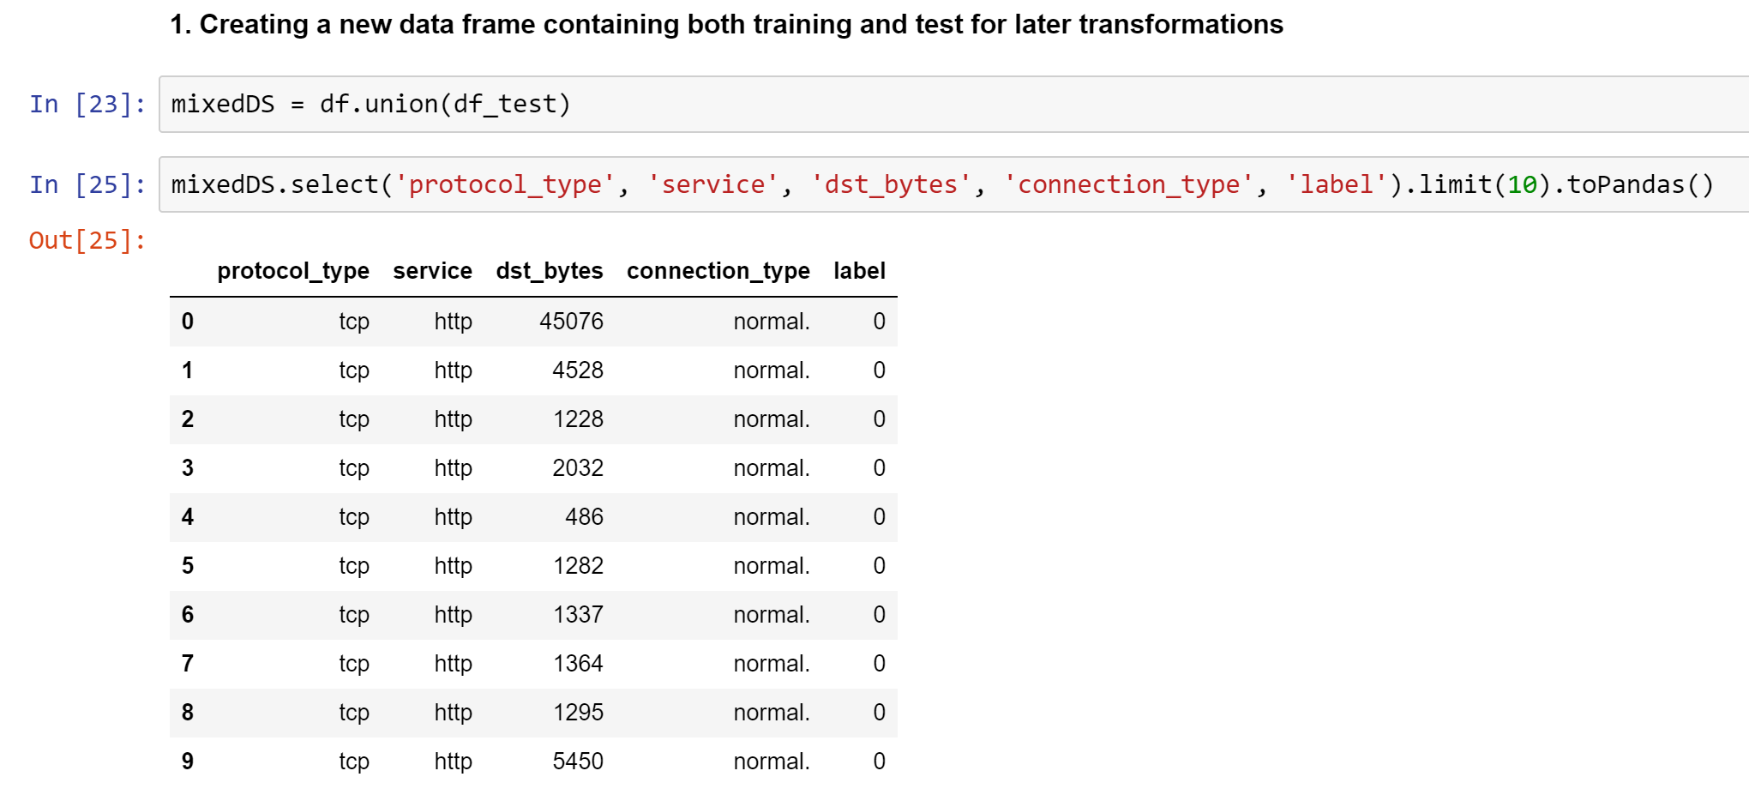
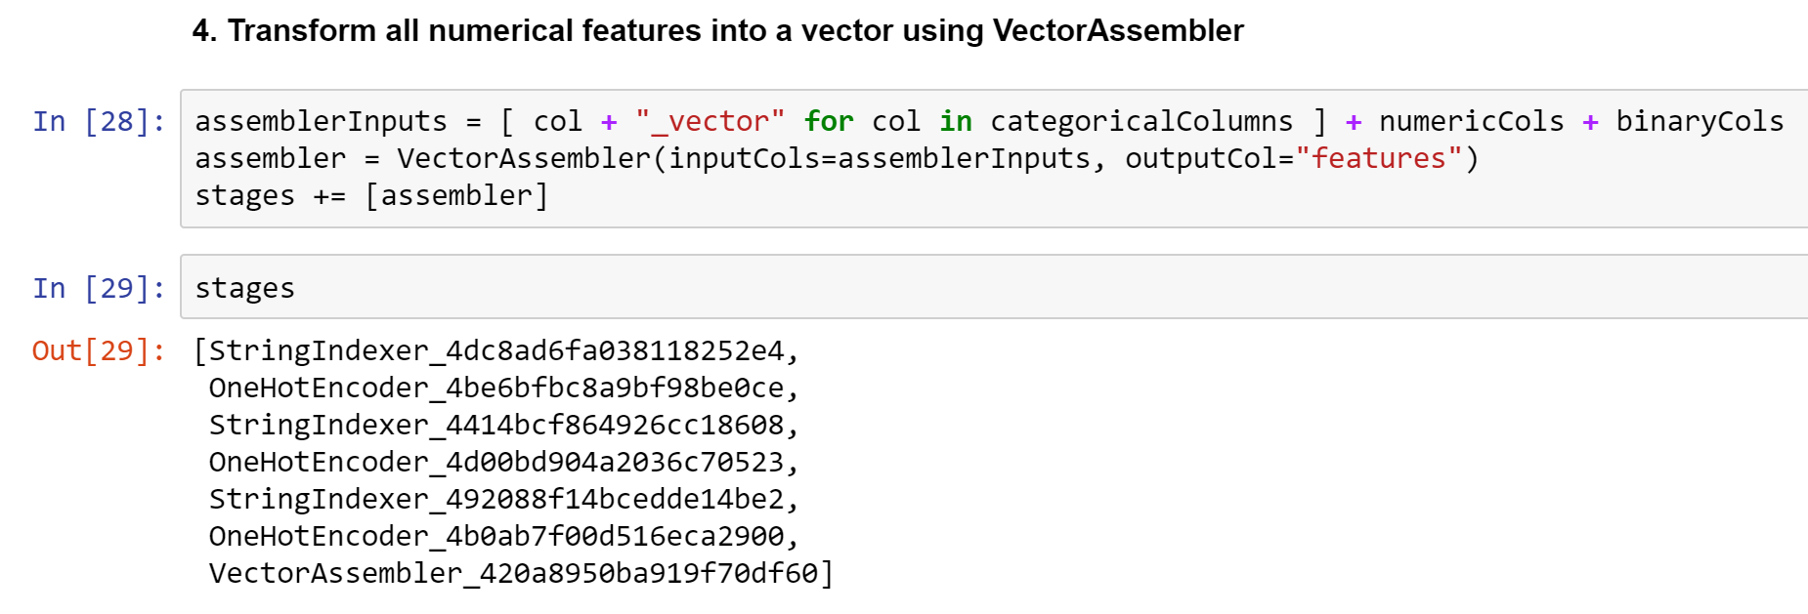
Data Preprocessing I
Merging Train and Test
Creating the Stages

Slide 6
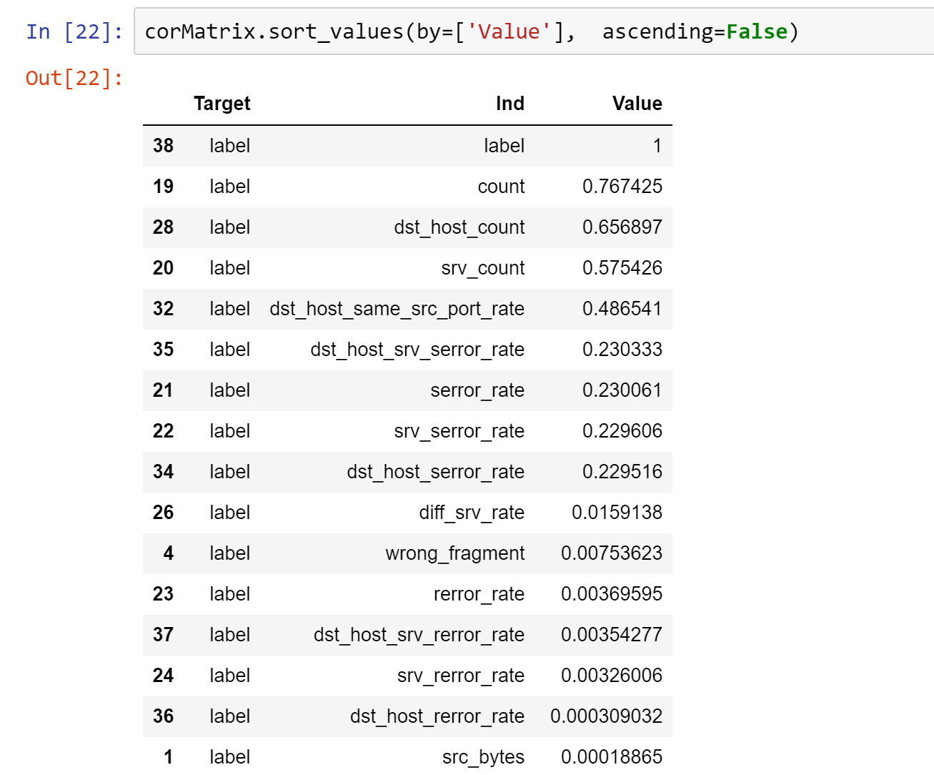
Data Preprocessing II
Numeric Columns:
Count
Dst_Host_Count
Srv_Count
Dst_host_same_src_port_rate
Logged_in
Categorical Columns:
Service
Protocol_Type
Flag
Connection_Type
Binary Columns:
logged_in
root_shell
su_attempted
is_host_login
is_guest_login

Slide 7
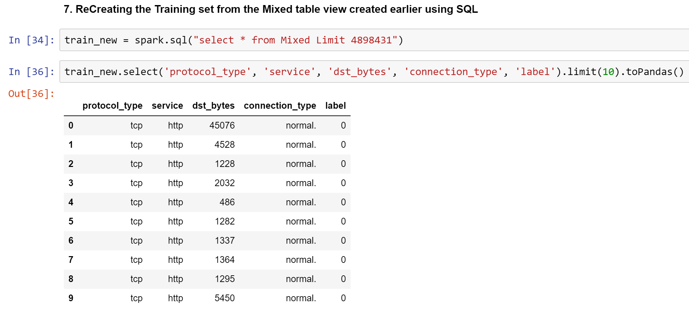
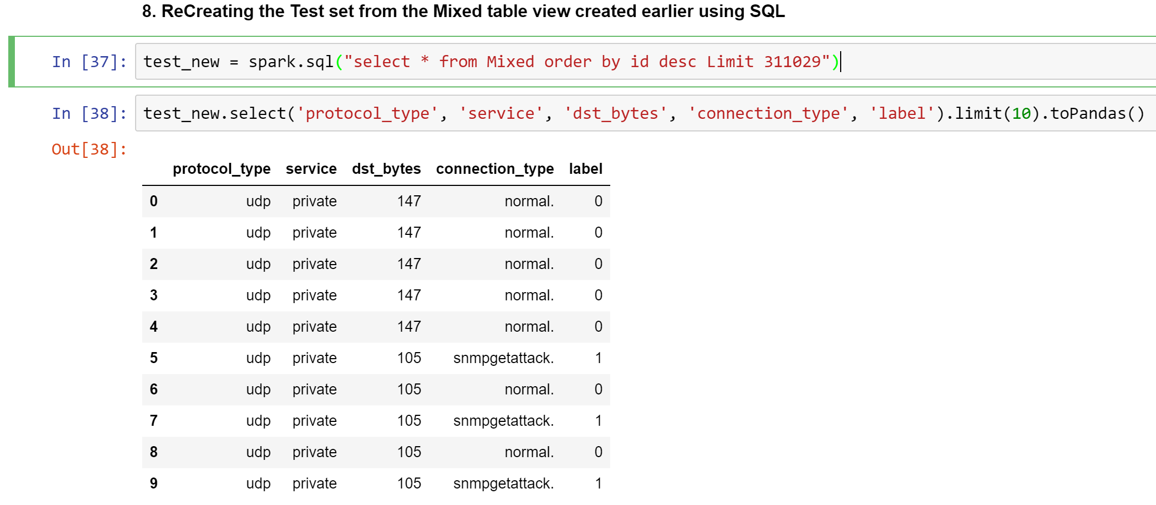
Data Preprocessing III
Splitting Merged into Train and Test

Slide 8
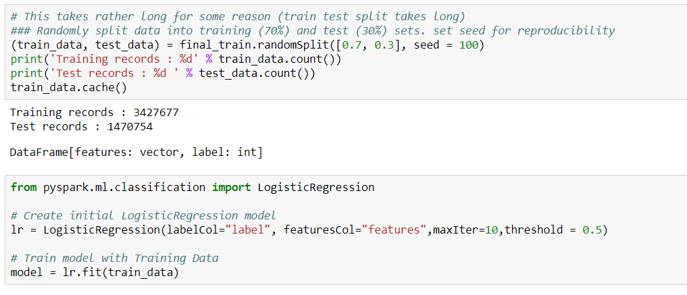
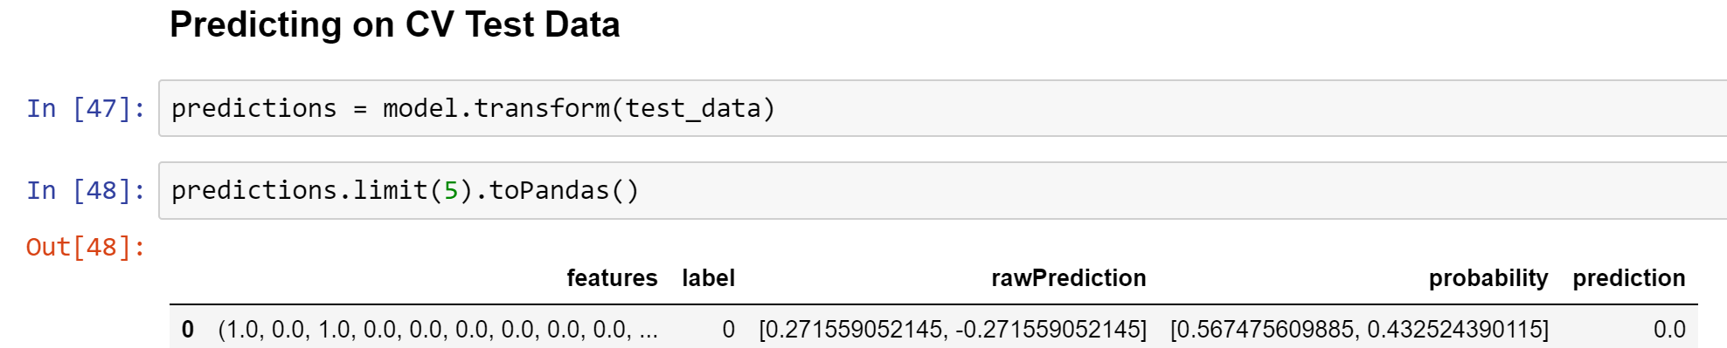
Data Modelling I
Train – test split
Logistics regression (assumes a hyper plane splitting the classes)
Amount of data
Decision threshold

Slide 9
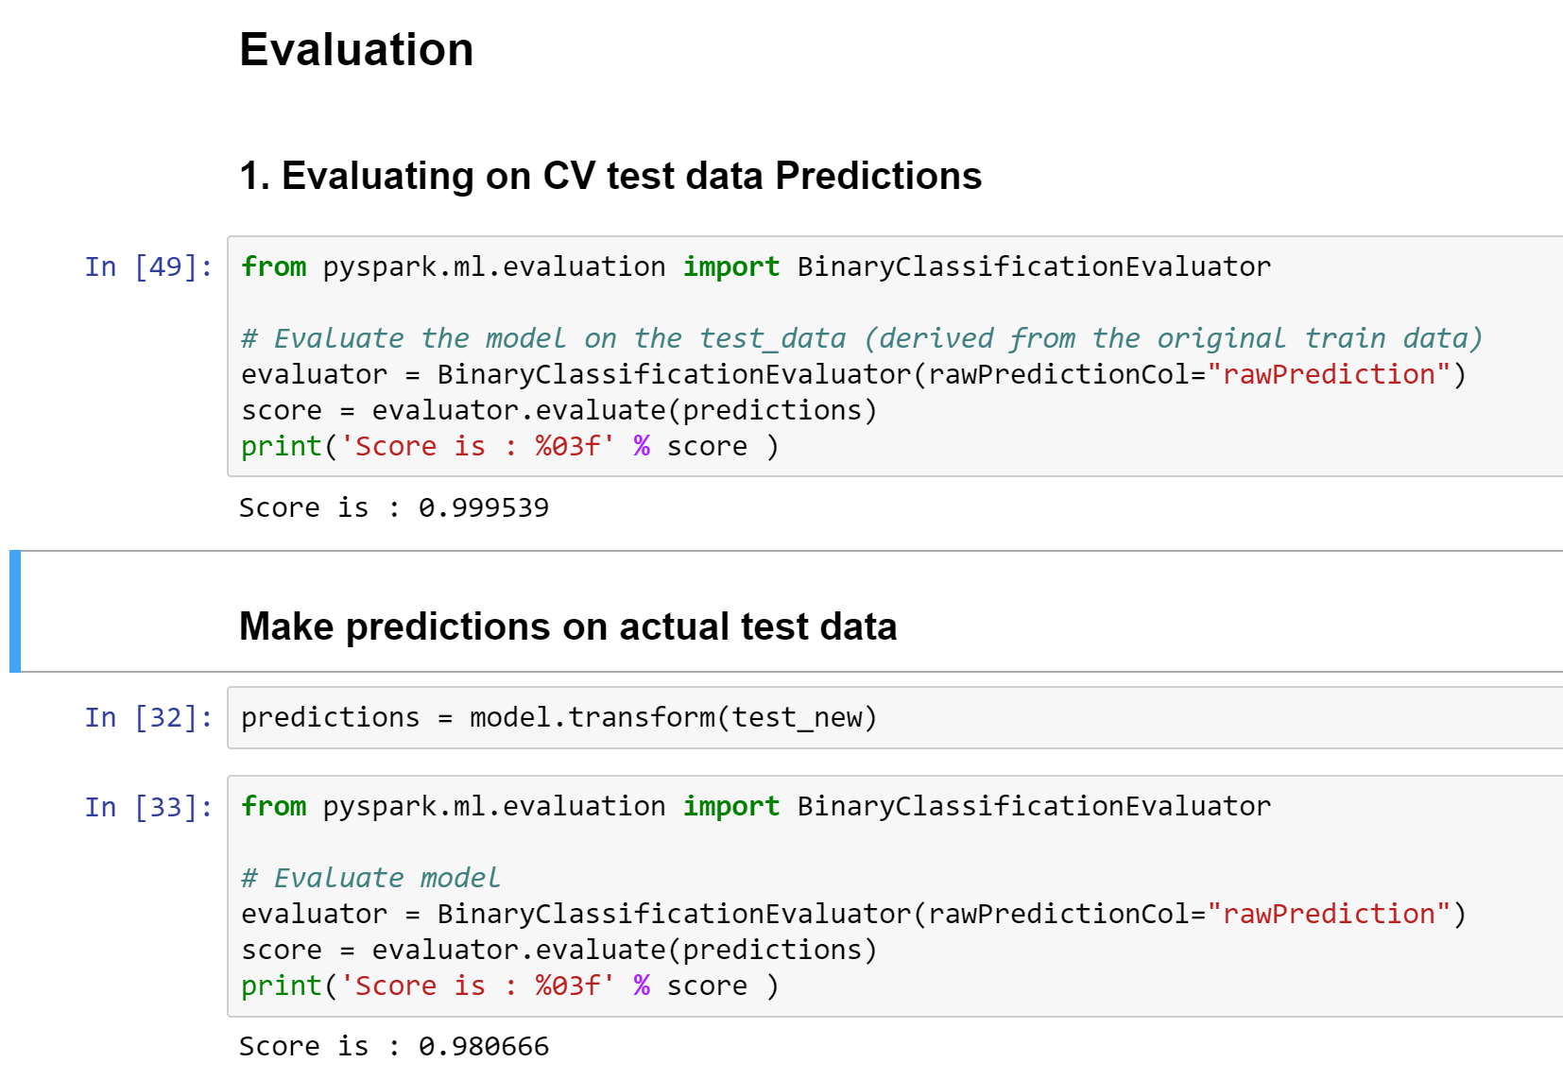
Data Modelling II
Fitting Training Data on a Logistic Regression Model

Slide 10
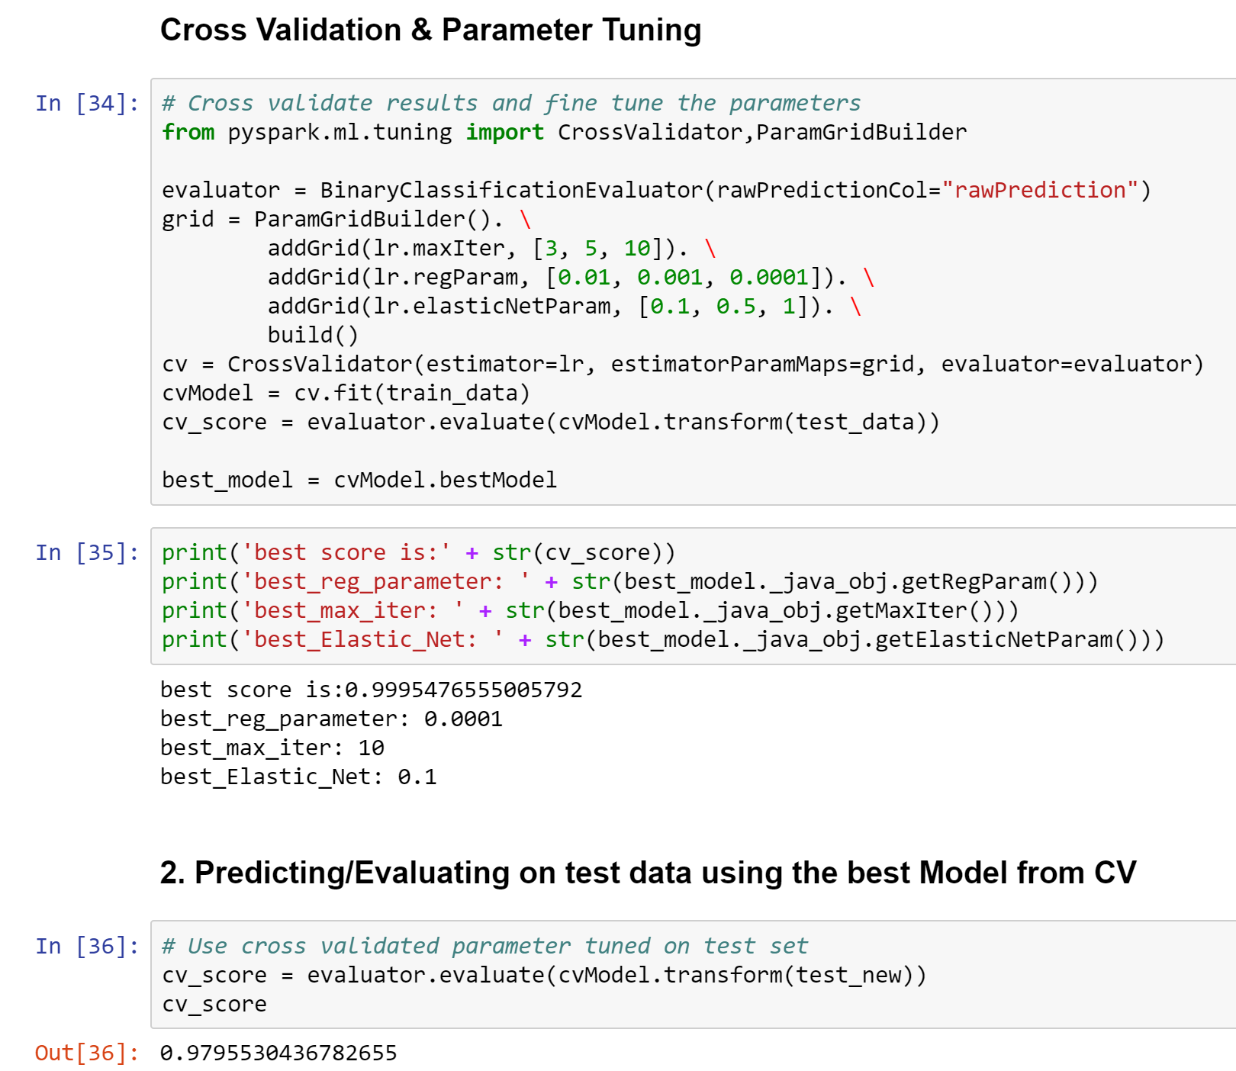

Data Modelling III
Cross Validation and Parameter Tuning
3%

Slide 11
Considerations and further improvements
SPARK IS AMAZINGLY FAST but…
Improvement in APIs and documentation
Server availability
Set up complexities
AMOUNT OF DATA TRUMPS ALGORITHM COMPLEXITY
HOW CAN WE MAKE IT BETTER:
Anomaly detection (k-means, non – linear SVMs (potentially through PCA), naïve bayes)
Non linear combinations of features
MOST IMPORTANTLY : Content knowledge

Slide 12
Thank You!😉

Slide 13
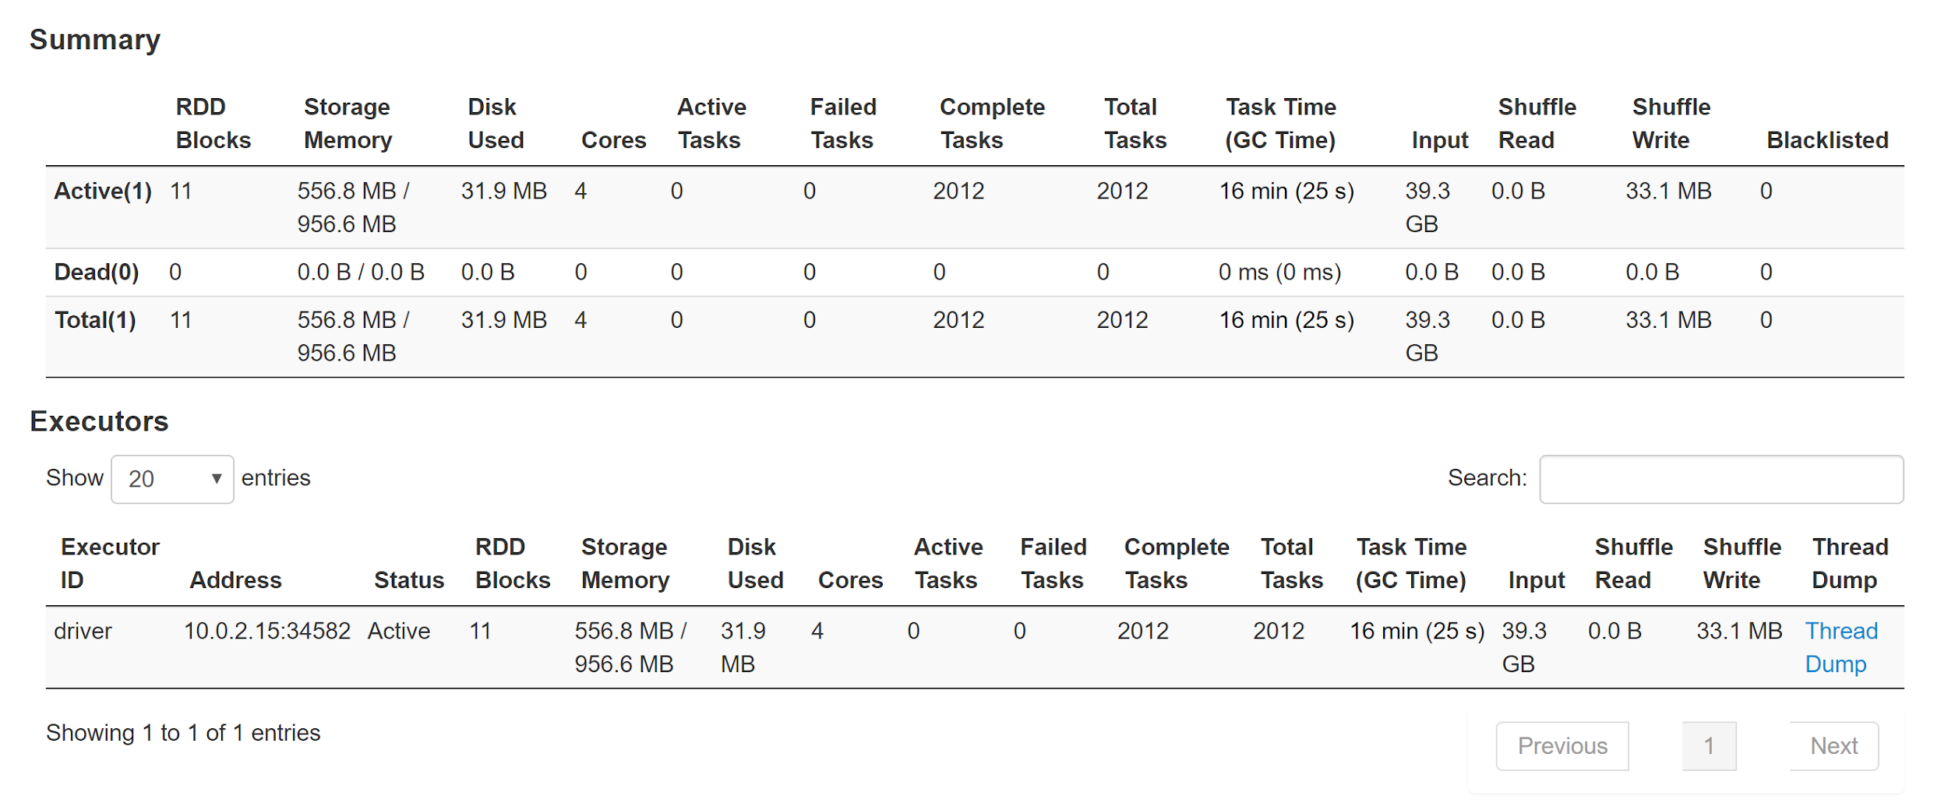
Appendix
Some fun facts😂

